Slide 1

Aqualytica : AI-Based Real-Time Water Contamination Monitoring and Prediction System
Presented By:
Ganesh Prasad (4MW23CS040)
Chaithanya Maiya (4MW23CS027)
Chirag S Poojary(4MW23CS030)
Sneha Ganesh (4MW23CS161)
Under the Guidance of
Ms. Savitha Shenoy
Assistant Professor(Sr.)
Dept. of CSE
SMVITM, Bantakal

Slide 2
Problem Statement
To develop an intelligent water quality monitoring system that can detect contamination in real time and predict future water quality using IoT sensors and machine learning techniques
Project Track
Applied Engineering- Industry-Based Project

Slide 3
Objectives
To develop a system that collects and analyzes water quality data such as pH, turbidity, TDS, , Conductivity ,Nitrate ,Chloride and temperature .
To implement machine learning algorithms for classification and prediction of water quality.
To detect anomalies in water parameters and provide alerts.
To develop a dashboard for visualization and monitoring.

Slide 4
Introduction
Water contamination is a major global issue that affects human health and environmental sustainability.
Early detection of contamination is important to prevent serious consequences.
IoT and machine learning enable real-time monitoring and intelligent analysis of water quality.
These technologies provide predictive insights for the early detection of contamination.
Water quality is assessed using parameters such as pH, turbidity, total dissolved solids (TDS), temperature, Conductivity ,Nitrate and Chloride.
Continuous monitoring of these parameters is more efficient than manual methods and helps ensure safe water quality.

Slide 5
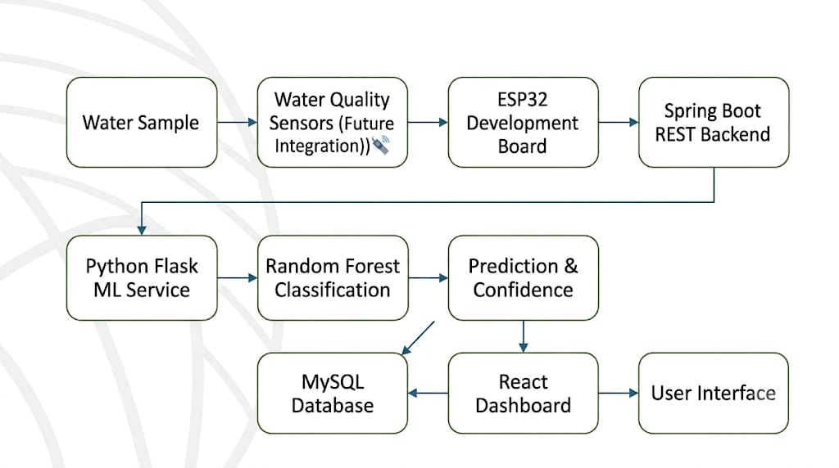
Methodology

Slide 6
Methodology
A water sample is analyzed by Water Quality Sensors (noted as a future integration), which send their readings to an ESP32 Development Board.
The ESP32 transmits the sensor data to a Spring Boot REST Backend, which acts as the main server routing the information.
The backend forwards the data to a Python Flask ML Service. Here, a Random Forest Classification algorithm processes the data to output a Prediction & Confidence score regarding the water quality.
The final predictions are stored in a MySQL Database. A React Dashboard retrieves this data (and potentially real-time data from the prediction step) to display it on the User Interface for the end user.

Slide 7
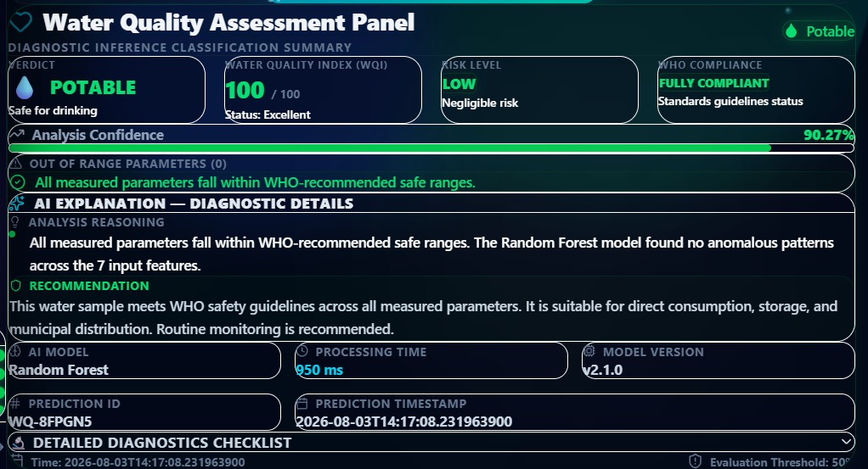
Results

Slide 8
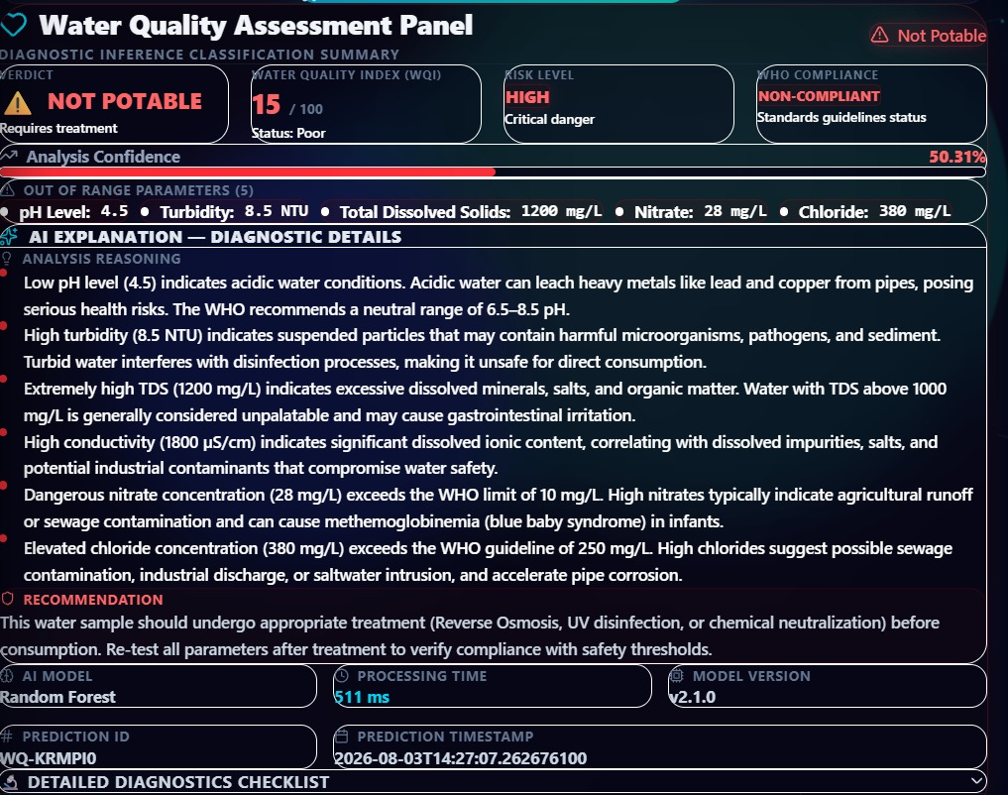
Results

Slide 9
Conclusion
The proposed Aqualytica system demonstrates how IoT and Artificial Intelligence can be integrated for real-time water quality monitoring and prediction.
By analyzing key parameters such as pH, turbidity, TDS, temperature, , Conductivity ,Nitrate and Chloride, the system enables early detection of water contamination and supports informed decision-making.
The combination of ESP32, Spring Boot, Python Flask, Random Forest, MySQL, and React provides a scalable and efficient architecture for intelligent monitoring.
Future work includes integrating real-time water quality sensors, improving prediction accuracy with larger datasets, and implementing automated alert and notification systems for practical deployment.

Slide 10
References
[1] S. Tinelli and I. Juran, “Artificial intelligence-based monitoring system of water quality parameters for early detection of contamination,” Water Supply, vol. 19, no. 6, pp. 1785–1795, 2019.
[2] W. Villegas-Ch, J. García-Ortiz, and S. Sánchez-Viteri, “Toward intelligent monitoring in IoT: AI applications for real-time analysis and prediction,” IEEE Access, vol. 12, pp. 40368–40380, Mar. 2024.
[3] P. K. Mahapatro, R. Panigrahi, and N. Padhy, “Integrated IoT and AI systems for real-time multi-nutrient water quality analysis in agriculture,” Engineering Proceedings, MDPI, 2024.
[4] T. Miller et al., “Integrating artificial intelligence agents with the Internet of Things for enhanced environmental monitoring: Applications in water quality and climate data,” Electronics, vol. 14, no. 696, 2025.
[5] S. Zou, H. Ju, and J. Zhang, “Water quality management in the age of AI: Applications, challenges, and prospects,” Water, vol. 17, no. 1641, 2025.

Slide 11
References
[6] S. Das et al., “AI and IoT supported sixth generation sensing for water quality assessment to empower sustainable ecosystems,” ACS ES&T Water, 2025.
[7] S. Al-Deen H. Hassan et al., “Using artificial intelligence to predict aquatic pollution: A comprehensive review,” International Journal of Aquatic Biology, vol. 13, no. 5, pp. 50–67, 2025.
[8] M. M. Alwakeel, “AI-assisted real-time monitoring of infectious diseases in urban areas,” Mathematics, vol. 13, no. 1911, 2025.
[9] A. Surahmat and D. B. R. W. Yato, “AI-based waste detection for water quality monitoring in rivers: A deep learning approach,” Gema Lingkungan Kesehatan, vol. 23, no. 3, pp. 333–343, 2025.
[10] P. Rohini, G. R. Kanagachidambaresan, and M. Muralidhar, “IoT-enabled real-time monitoring and disease prediction system for sustainable aquaculture,” IEEE Access, vol. 14, pp. 32506–32520, Feb. 2026.

Slide 12
THANK YOU

